Slide 1

Data doctors
A deep insight into the covid-19 outlook up until today

Slide 2



Who we are …
Alexandros Rammos
Eleftherios Morits

Slide 3
Introduction
In the face of the ongoing global pandemic, our team at Data Doctors has been dedicated to unraveling key patterns and trends within COVID-19 data. Today, we'll take you through our comprehensive analysis, covering two distinct data sets, employing advanced Exploratory Data Analysis (EDA) techniques in Python, and presenting our findings through a powerful Business Intelligence (BI) dashboard.

Slide 4

Exploratory Data Analysis (EDA) in Python

Slide 5

Scope of Analysis
Notes:
Stay as far away as possible from others when coughing or sneezing; better yet, face away from them. Sneeze into the crook of your arm or into a paper handkerchief that you then throw away immediately. Avoid touching other persons when greeting them and wash your hands regularly and thoroughly for at least 20 seconds with soap and water.

Slide 6

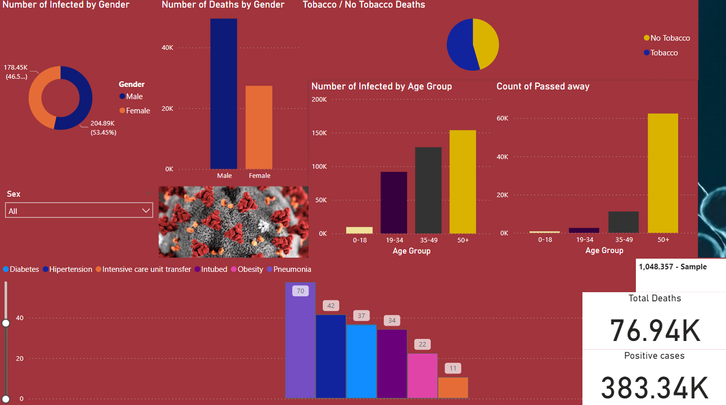
Business Intelligence (BI) Dashboard

Slide 7
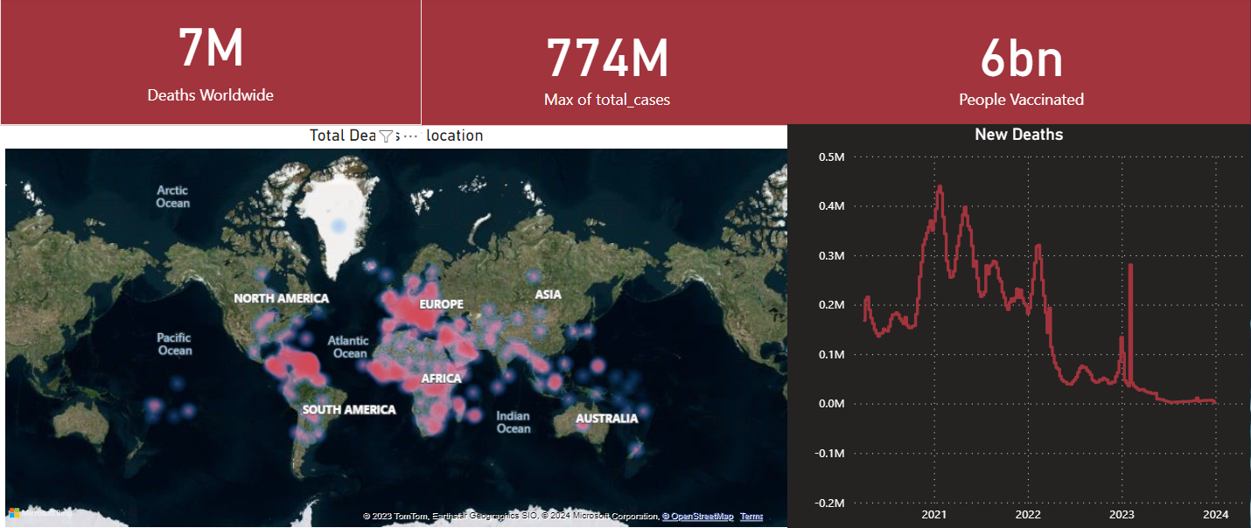
Business Intelligence (BI) Dashboard

Slide 8
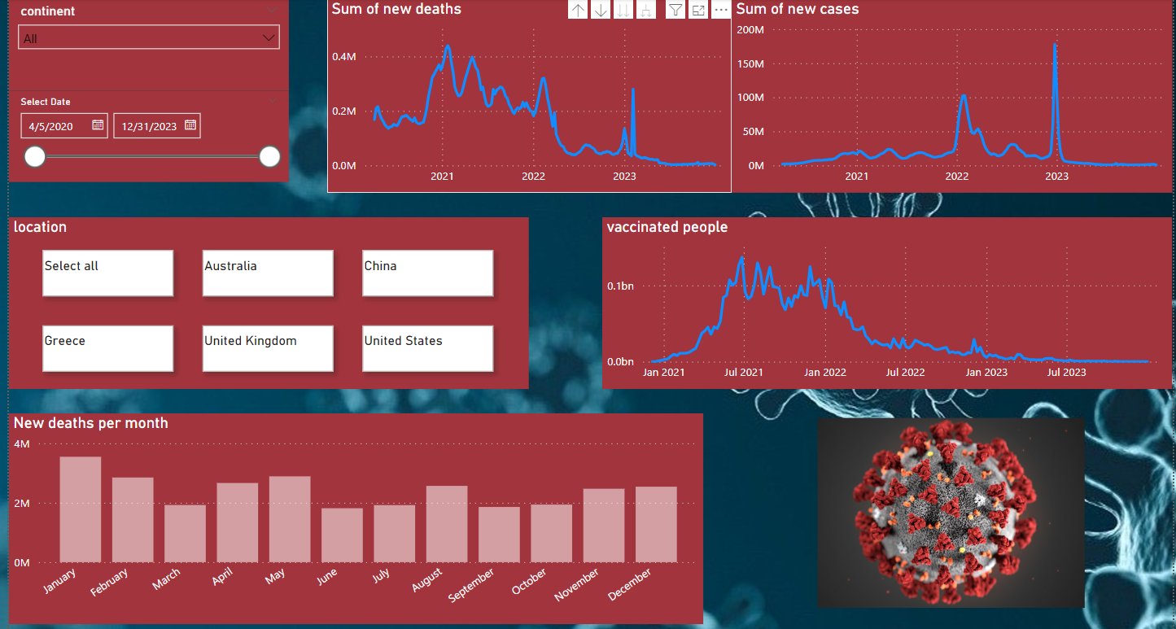
Business Intelligence (BI) Dashboard

Slide 9

Key Findings
Notes:
Stay as far away as possible from others when coughing or sneezing; better yet, face away from them. Sneeze into the crook of your arm or into a paper handkerchief that you then throw away immediately. Avoid touching other persons when greeting them and wash your hands regularly and thoroughly for at least 20 seconds with soap and water.

Slide 10

Q&A
Alexandros Rammos Eleftherios Morits

Slide 11

Thank You

